Slide 1
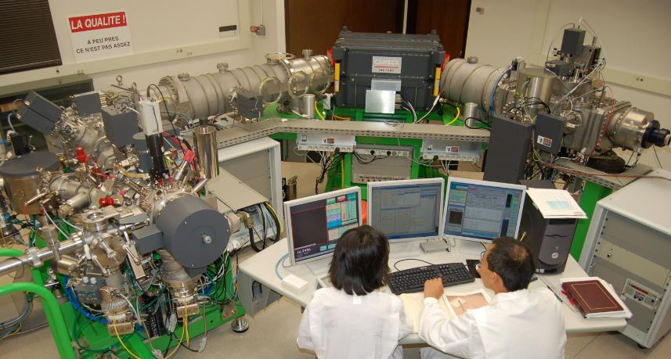
SIMS Basics

Slide 2
Secondary Ion Mass Spectrometer (SIMS)
Secondary ions are produced by the sputtering of primary ions
**Surface analysis**
Electrostatic Field
Magnetic Field
Primary Ion
(+10kV/−13kV)
fixed magnet strength
Double focusing
Mass Spectrometer
Secondary Ion
E-gun
¹⁶O
¹⁸O
±10kV
“multi-collection mode”
Sample
Ion counters
Simplified Schematic of SIMS
Notes:
-Because this is a mass spectrometer, we can distinguish and compare ratios of different isotopes of a given element or compound.
-In the sims configuration, there are two configurations to detect secondary ions.
In the first configuration the magnet has a fixed field strength. In this configuration:
-the lighter isotopes are more sharply bent in their travel path when compared to heavier isotopes. At the end of the travel path we have
multiple collectors to detect and count each isotopologue. This is referred to as a “multi-collection” configuration.

Slide 3
Secondary Ion Mass Spectrometer (SIMS)
Secondary ions are produced by the sputtering of primary ions
**Surface analysis**
Electrostatic Field
Magnetic Field
Primary Ion
(+10kV/−13kV)
variable magnet strength
Double focusing
Mass Spectrometer
Secondary Ion
¹⁶O or ¹⁸O
E-gun
¹⁶O
¹⁸O
“peak-jumping” or “mono-collection” mode
±10kV
Sample
Ion counters
Simplified Schematic of SIMS
Notes:
In a second type of collection, the magnet strength is varied, which allows isotopes of different masses to be steered onto one detector. This is referred to as either peak-jumping or mono-collection.

Slide 4
Courtesy: Rick Hervig, ASU
Notes:
Courtesy of Rick Hervig, SIMS specialist at ASU

Slide 5
Courtesy: Rick Hervig, ASU
Notes:
Courtesy of Rick Hervig, SIMS specialist at ASU

Slide 6
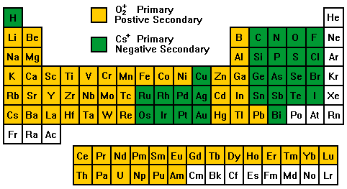
Most of elements in periodic table are ionized
Primary Ions
Cs: +10kV
O−: −13kV
Secondary Ions
Primary Cs+ → Secondary negative ions
Higher electronegativity: O⁻, C⁻, S⁻, Si⁻
Primary O⁻ → Secondary positive ions
Higher ionization tendency: Mg+, Ca+, Pb+
Sample
±10kV
- Noble gases do not ionize.
Primary O⁻/Sec(+)
*Ionization efficiency varies significantly
from 0.1 to 10%. More efficient = better counting statistics = higher precision data.
*Efficiency depends on bonding and structural characteristics of the sample.
Primary Cs⁺/Sec(−)
Modified from Evans Analytical Group: http://www.eaglabs.com/mc/sims-theory.html
Notes:
Most elements on the periodic table are ionized by SIMS, but they are ionized with different sources. Positively charged primary ion sources produce negatively charged secondary ions, while negatively charged primary ions yield positively charged secondary ions. An important consideration when using SIMS is the ionization efficiency of the sample. The ionization efficiency is directly related to counting statistics, and therefore the precision that can be achieved. The ionization efficiency itself is influences by the bonding characteristics and the structural characteristics of the samples that you are analyzing.

Slide 7
Sputtering: Ejection of atoms
Primary Ion ¹³³Cs+
Impact energy 20 keV
0V
Ejected atoms
“Sputtering"
Primary ions are implanted to the interior of sample.
Atoms in the sample are displaced by collision cascade. Lattice structures are destroyed and amorphous layer (~30 nm) is formed.
Some atoms are ejected from the surface = sputtering
-10kV
amorphous layer

Slide 8
Secondary Ion Generation
Most (>90%) atoms and molecules are neutral.
Some are ionized and are accelerated by a 10kV electro-static field
Extraction
0V
e
e
e
e
e
e
e
e
e
e
e
e
e
e
e
neutral atoms
e
e
e
e
e
neutral molecules
e
e
e
e
atomic ions (−)
e
e
-10kV
molecular ions (−)
e
Electrons (−)
Sample
High Voltage

Slide 9
Sample charging by the loss of electron
Electron is easily ejected out from the sample by the same -10kV field !
Extraction
0V
e
e
e
e
e
e
e
e
e
e
e
e
e
e
e
neutral atoms
e
e
e
e
e
neutral molecules
e
e
e
e
e
e
e
e
e
e
atomic ions (−)
Gold coat
e
e
-10kV
molecular ions (−)
e
Electrons (−)
Sample
High Voltage
Your samples are insulators!!

Slide 10
Sample charging by the loss of electron
What will happen if electron is lost?
Extraction
Secondary ions can not pass through the mass spectrometer, which is tuned for -10kV extraction voltage.
0V
e
e
e
e
e
e
e
e
e
e
e
e
e
e
e
neutral atoms
e
e
e
e
e
neutral molecules
e
e
e
e
atomic ions (−)
e
e
-10kV
-9.5kV
-9.9kV
-9.0kV
molecular ions (−)
e
Electrons (−)
Sample
High Voltage

Slide 11
Sample charging by the loss of electron
What would happen if we can not supply any electrons?
Extraction
0V
e
e
e
e
e
e
e
e
e
e
e
e
e
e
e
neutral atoms
e
e
e
e
e
neutral molecules
e
e
e
e
atomic ions (−)
e
e
-10kV
-9.5kV
?? kV
-9.9kV
-9.0kV
molecular ions (−)
e
Electrons (−)
Sample
High Voltage
Electrostatic discharge!
…on your sample?

Slide 12
Secondary Ion Mass Spectrometer (SIMS)
Secondary ions are produced by the sputtering of primary ions
**Surface analysis**
Electrostatic Field
Magnetic Field
Primary Ion
(+10kV/−13kV)
Double focusing
Mass Spectrometer
Secondary Ion
E-gun
¹⁶O
¹⁸O
Electron Gun
±10kV
Sample
Ion counters
Simplified Schematic of SIMS

Slide 13
……from a certain point of view
From Kevin McKeegan. UCLA SIMS workshop 2009

Slide 14
……from a certain point of view
WiscSIMS: typically 1 to 40 micron spots, < 1 micron deep
From Kevin McKeegan. UCLA SIMS workshop 2009

Slide 15
Focusing electrons and ions. Tuning the SIMS.
Double Focusing
Mass Spectrometer
Primary Ion
Sources
Ion Detection
Sample & Secondary Ions
Electron Gun
Total secondary ion travel distance: ~10 m
Notes:
If we look at a more detailed schematic of the SIMS what we can see is that there are many many lenses that need to be adjusted in order to do focusing. The flight paths of the primary ion beam, the electrons from the electron gun, and the secondary ions produced all need to be focused well, in order to produce meaningful data. Like the electron microprobe, the focusing is achieved through the use of electrostatic lenses. In addition, there are several places along flight paths where we have slits and apertures, to assist with tuning. These essentially cut out primary and secondary ions. Essentially when tuning up a beam its important to consider how big of an area you can reasonably analyze. Once you know that you can see how well you can focus the beam and see how small you can get it and what kind of beam shape you can achieve. If the beam is too large and/or poorly shaped, you can then introduce slits and apertures to make a smaller beam that’s better shaped.

Slide 16
Secondary Ion Mass Spectrometer (SIMS)
Secondary ions are produced by the sputtering of primary ions
**Surface analysis**
Electrostatic Field
Magnetic Field
Primary Ion
(+10kV/−13kV)
Double focusing
Mass Spectrometer
Secondary Ion
E-gun
¹⁶O
¹⁸O
Electron Gun
channel plate detector for secondary ion imaging
±10kV
Sample
Ion counters
Simplified Schematic of SIMS
Notes:
So how do we know if we are tuning the beam properly? To help us with this, the SIMS is equipped with a channel plate, which is a detector that can image the secondary ions.

Slide 17
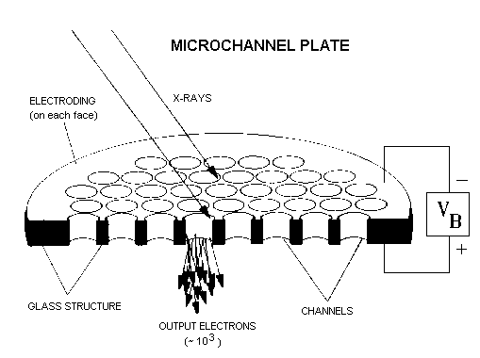
adweb.desy.de
secondary ions
(a.k.a electron multipliers)
output electrons are converted to an image
fun fact: this is the basis for night vision goggles.
Notes:
So what is a channel plate? Essentially it is an array of tiny electron multipliers. When a secondary ion hits the channel plate the signal is converted to an electron, which then cascades through the electron multipler. The electron signal is then processed and converted into an image.

Slide 18
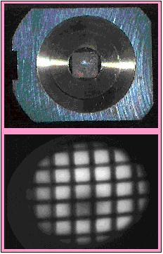
Beam tuning by imaging of secondary ions
25 mm
sample holder with Cu grid masking an Al backing
grid
channel plate secondary ion image of ²⁷Al⁺. Grid spacing is 25 microns.
http://epswww.unm.edu/iom/SIMSgear.html
Notes:
We can further take advantage of imaging for beam tuning by having a sample with an easy to recognize pattern. Most SIMS labs nowadays have mesh, or grid, tuning samples. Here we can see an example of a SIMS sample holder with a copper grid pressed into an aluminum backing. With the channel plate we can then detect 27Al secondary ions to produce an image. For tuning of the secondary ion flight path, we can optimize the image of the grid with lens alignment that gets rid of tilt and aberration. For other parts of the instrument like primary beam tuning and electron gun tuning we can also take advantage of images projected onto the channel plate, and we can adjust lenses to get the desired image we know correspond to well-focused part of the flight path. In addition we can use the channel plate to see how wide or narrow slits are, and how big or small the sputtered region will be with certain apertures put into place.

Slide 19
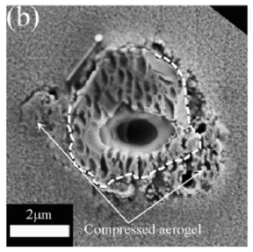
Spot size vs. primary ion beam intensity vs. analytical precision
Cs+ primary beam 10-15 µm spots
Cs+ primary beam 1-2 µm spots
Foraminifera; Kozdon et al. (2011)
Comet sample return; Nakashima et al. (2012)
Primary Ion intensity ~ 2 nA
Precisions of oxygen isotope ratios ~ 0.3‰
3 pA
1-2 ‰
*It is critical to determine how large of a spot size you can accommodate when analyzing regions in samples by SIMS!!
**Often SEM and EPMA are used to determine such sample characteristics.

Slide 20
controlling mass resolution with the entrance slit
Double Focusing
Mass Spectrometer
Primary Ion
Sources
Ion Detection
Sample & Secondary Ions
Electron Gun
Total secondary ion travel distance: ~10 m
Notes:
If we look at a more detailed schematic of the SIMS what we can see is that there are many many lenses that need to be adjusted in order to do focusing. The flight paths of the primary ion beam, the electrons from the electron gun, and the secondary ions produced all need to be focused well, in order to produce meaningful data. Like the electron microprobe, the focusing is achieved through the use of electrostatic lenses. In addition, there are several places along flight paths where we have slits and apertures, to assist with tuning. These essentially cut out primary and secondary ions. Essentially when tuning up a beam its important to consider how big of an area you can reasonably analyze. Once you know that you can see how well you can focus the beam and see how small you can get it and what kind of beam shape you can achieve. If the beam is too large and/or poorly shaped, you can then introduce slits and apertures to make a smaller beam that’s better shaped.

Slide 21
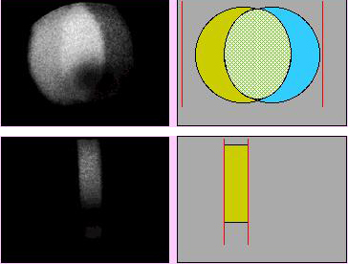
Mass of ⁴⁰Ca¹⁶O: 55.93494 amu. Mass of ⁵⁶Fe: 55.95750 amu. ΔM: 0.02256 amu.
Mass resolving power = M/ ΔM. In this case, the minimum mass resolving power to distinguish the signals, 55.95750/0.02256 amu = 2480.
channel plate secondary ion image
Green: Fe. Blue: CaO
Circular contrast aperture: 750 µm dia.
Wide slit width (> 750 µm). Mass resolving power: 300.
slit
slit
Narrow slit width (~100 µm). Mass resolving power: 2850.
http://epswww.unm.edu/iom/SIMStrace.html
slit
slit

Slide 22
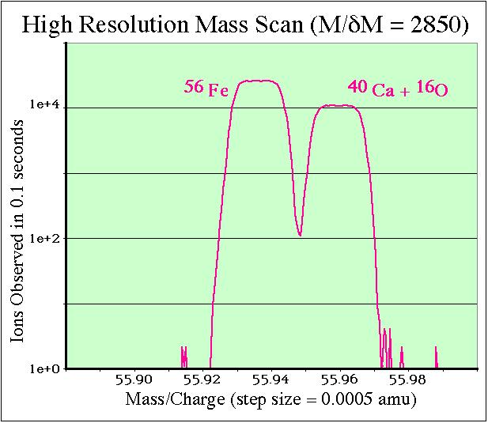
The entrance slit width sets the mass resolving power
http://epswww.unm.edu/iom/SIMStrace.html
BUT…it also limits the amount of secondary ions passing through to the counters, influencing analytical precision. This needs to be considered!

Slide 23
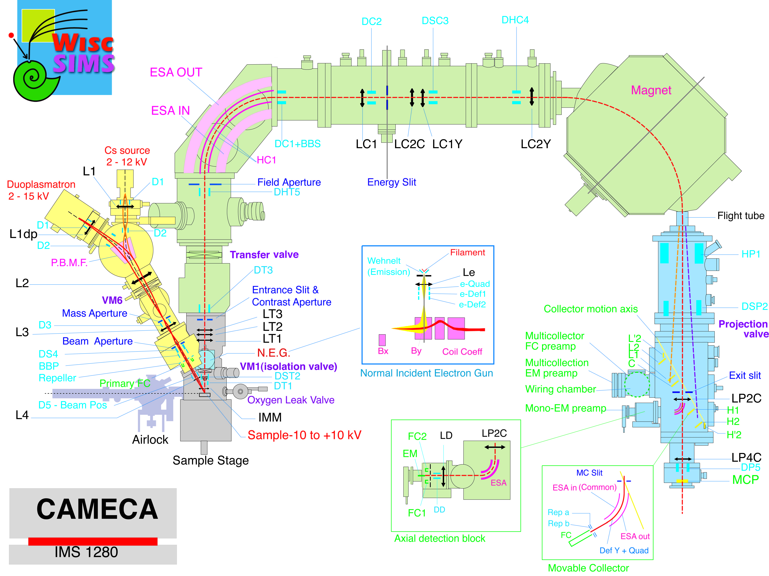
On our instrument there are actually multiple slits for better tuning control on the mass resolving power
Energy Slit
Field Aperture
Entrance slit
Exit Slit
Notes:
Often however, we only have to close one or two slits, because we can achieve good alignment through other focusing mechanisms.

Slide 24
the detection system
Double Focusing
Mass Spectrometer
Primary Ion
Sources
Ion Detection
Sample & Secondary Ions
Electron Gun
Total secondary ion travel distance: ~10 m
Notes:
If we look at a more detailed schematic of the SIMS what we can see is that there are many many lenses that need to be adjusted in order to do focusing. The flight paths of the primary ion beam, the electrons from the electron gun, and the secondary ions produced all need to be focused well, in order to produce meaningful data. Like the electron microprobe, the focusing is achieved through the use of electrostatic lenses. In addition, there are several places along flight paths where we have slits and apertures, to assist with tuning. These essentially cut out primary and secondary ions. Essentially when tuning up a beam its important to consider how big of an area you can reasonably analyze. Once you know that you can see how well you can focus the beam and see how small you can get it and what kind of beam shape you can achieve. If the beam is too large and/or poorly shaped, you can then introduce slits and apertures to make a smaller beam that’s better shaped.

Slide 25
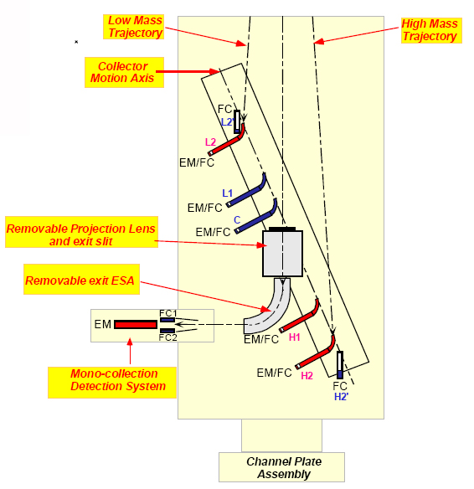
the detection system
EM = electron multiplier.
FC = Faraday cup
-detectors are movable.
-selection of EM versus FC depends on the count rate of the signal in question.
Ex: EM’s can become saturated is the count rate of a particular isotope is too high. This will yield unreliable data (and shorten the life of the EM!).

Slide 26
Quantitative analysis of phases, calibrating due to matrix effects.
measured difference in δ¹⁸O, relative to the known value (‰)
diff
Molar fraction of Ca-endmember garnet component
Ickert and Stern 2013. Geostandards and Geoanalytical Research

Slide 27
What causes matrix effects?
-It is an integrated effect, combining:
Influences from the sputtering process;
Transmission into the mass spectrometer;
Transmission through the mass spectrometer;
Influences from the detection system;
The composition of the phase analyzed;
The structure of the phase analyzed.
Essentially, any minor change to a given analytical setup can have a profound influence on the extent of the matrix correction. Therefore, matrix calibration must be performed every time for every session, and must be performed for every phase being analyzed.

Slide 28
matrix effects of common isotope systems measured by the WiscSIMS ims 1280
Instrumental bias = (^{A}X/^{B}X)_{SIMS} /(^{A}X/^{B}X)_{True}
O-isotopes (¹⁸O/¹⁶O) in silicate, carbonates, and oxide minerals: ±10‰
C- isotopes (¹³C/¹²C) in calcite: −40‰
Si isotope (³⁰Si/²⁸Si) in quartz: −30‰

Slide 29
How do we know where we are aiming? Surface imperfections can be our friends (just make sure to miss them when analyzing).
optical microscope image of sample surface.
50 µm
corresponding BSE image of sample surface.
low-Ca pyroxene
* EPMA/SEM greatly aids with SIMS navigation
basaltic glass
Tenner et al. 2009. Chemical Geology
Notes:
Cracks and pits should be avoided during SIMS analysis because they often have contaminants in them, either from natural processes, or from sample preparation, including epoxy or other mounting materials, and residual grit from polishing.

Slide 30
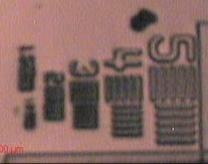
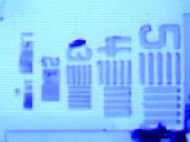
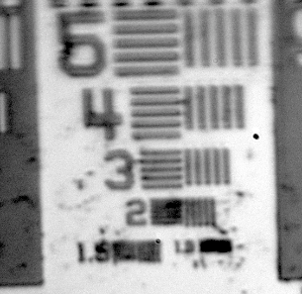
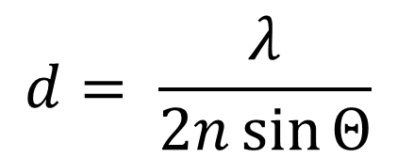
Improved optical resolution on the WiscSIMS IMS-1280
Numbers in images correspond to width and spacing of lines, in microns
Original
(halogen light)
Blue LED
(450 nm)
UV LED
(370 nm)
Abbe diffraction limit
$$d= \frac{λ}{2n\sin{Θ}}$$
light source wavelength
optical resolution
numerical aperture
It is much easier to aim best position for the analysis
Notes:
However, even with the UV LED, it is difficult to optically distinguish features less than 1 micron in size.

Slide 31
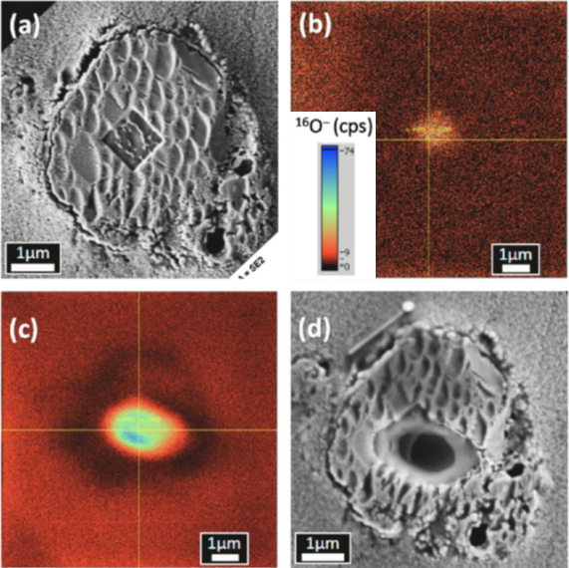
Need a 1 micron spot analysis? FIB marking for navigation by SIMS (a.k.a. DIY topography)
FE-SEM image of FIB-marked square at region of interest. (Depth: ~30 nm)
channel plate secondary ion image of FIB mark
channel plate secondary ion image of SIMS analysis pit
FE-SEM image of SIMS analysis pit.
Nakashima et al. 2012. EPSL. Particles returned from the comet Wild 2. Note: standards were also FIB marked to account for any topographic effects.

Slide 32
Too much topography becomes our enemy…
matrix effect
topography effects
Kita et al. 2009. Chemical Geology. Quartz
-due to disturbing electric fields around the sample.
rim
center
-it is important that samples have flat, untilted surfaces (some micron-scale surface pits and cracks are OK).

Slide 33
Flat surfaces promote a high degree of analytical precision
<1 µm of topography from center to edge of grain
analytical precision improves immensely (in this case ± 0.2 ‰ 2SD)
matrix effect
Kita et al. 2009. Chemical Geology.

Slide 34
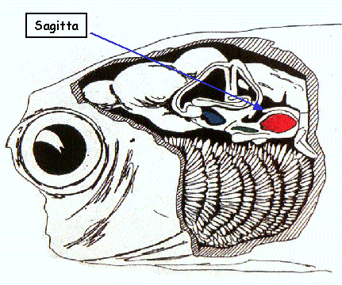
SIMS yields spatially resolved isotopic data. An in-situ technique
Fish otolith. Each numbered band corresponds to a year of growth (90 = 1990)
misclab.umeoce.maine.edu
500 µm
Matta et al. 2013. Rapid Communications in Mass Spectrometry
Notes:
Ootolith = calcifies structure in the inner ear of fish. One annulus per year.

Slide 35
SIMS yields spatially resolved isotopic data. An in-situ technique
each data point = 10 µm SIMS spot analysis
O- isotope ratios of otoliths are influenced by the temperature and isotopic composition of water. Unaffected by biological processes.
distance from otolith center (µm)
Matta et al. 2013. Rapid Communications in Mass Spectrometry

Slide 36
SIMS yields spatially resolved isotopic data. An in-situ technique
each data point = 10 µm SIMS spot analysis
Decreasing water temperature (4 ⁰C for every 1 ‰).
distance from otolith center (µm)
Juvenile: located in shallow, warmer water
Adult: movement into deeper water
Matta et al. 2013. Rapid Communications in Mass Spectrometry

Slide 37
SIMS yields spatially resolved isotopic data. An in-situ technique
each data point = 10 µm SIMS spot analysis
Decreasing water temperature (4 ⁰C for every 1 ‰).
distance from otolith center (µm)
Saw tooth up: Winter
Saw tooth down: Summer
Matta et al. 2013. Rapid Communications in Mass Spectrometry

Slide 38
SIMS yields spatially resolved isotopic data. An in-situ technique
each data point = 10 µm SIMS spot analysis
Decreasing water temperature (4 ⁰C for every 1 ‰).
Active seeking of constant water temperatures?
distance from otolith center (µm)
Matta et al. 2013. Rapid Communications in Mass Spectrometry

Slide 39
SIMS yields spatially resolved isotopic data. An in-situ technique
each data point = 10 µm SIMS spot analysis
no growth
rapid growth
distance from otolith center (µm)
**overall, such data over the life cycle of this fish would not be fathomable by analyzing this otolith by either a bulk technique or a larger spot technique
Matta et al. 2013. Rapid Communications in Mass Spectrometry

Slide 40
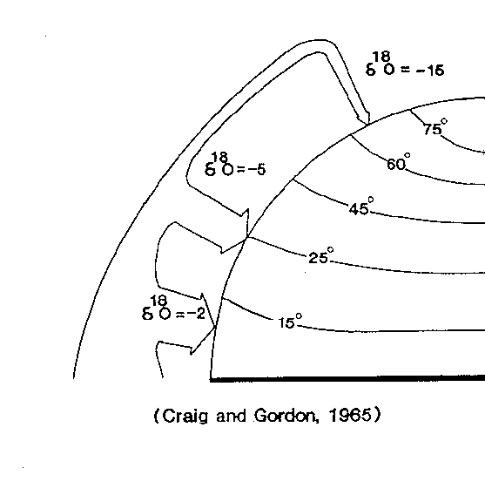
Why do isotopes make such good proxies for processes? They fractionate. Example: evaporation and condensation effect on oxygen isotope ratios of water vapor at latitude
decreasing temperature; increasing condensation from vapor.
‰
‰
‰

Slide 41
¹⁷O fractionates about half as much as ¹⁸O
δ¹⁷O: ‒ 7.5 ‰
‰
δ¹⁷O: ‒ 2.5 ‰
‰
δ¹⁷O: ‒ 1 ‰
‰
Mass difference, relative to ¹⁶O: ¹⁷O: (17-16)/16 = 1/16
¹⁸O: (18-16)/16 = 1/8

Slide 42
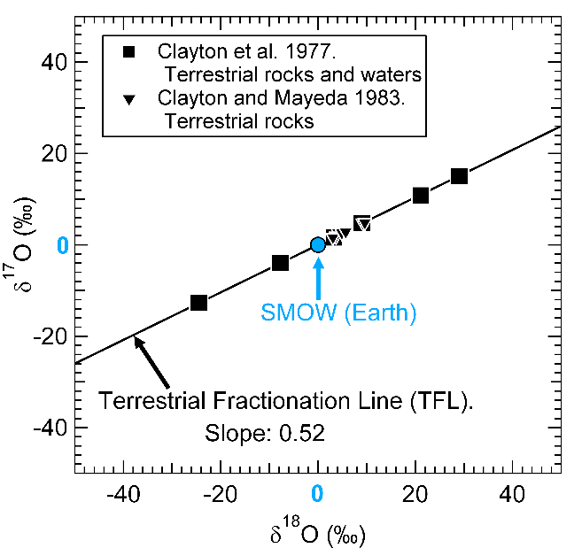
mass dependent fractionation in terrestrial materials
Notes:
On earth we see evidence of mass dependent fractionation in other rocks and waters and when comparing delta 18O to delta 17O, these data define the terrestrial fractionation line, which unsurprisingly has a slope of about ½.

Slide 43
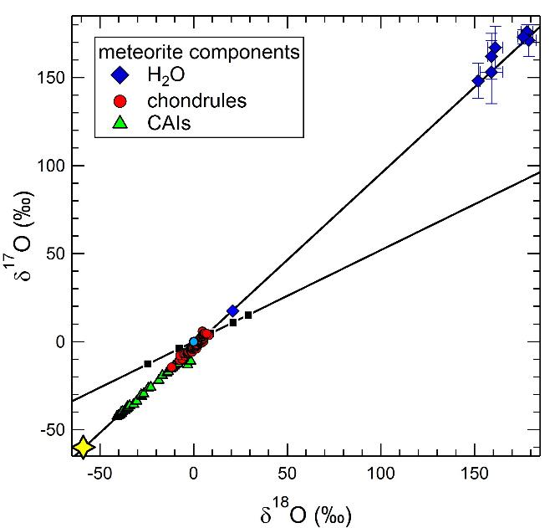
Mass independent O-isotope fractionation in components from undifferentiated meteorites
(heavy isotope enriched)
mass independent fractionation. slope 1 line
chondrule data: Krot et al. 2009
CAI data: Clayton, 1993
Sun data: McKeegan et al 2011.
TFL
Meteorite H₂O data: Choi et al. 1998; Sakamoto et al. 2007.
Earth
Mass dependent fractionation. Slope 0.52.
Sun
(light isotope enriched)

Slide 44



Mass independent breakdown of CO gas (the dominant species) on the surface of a protostellar disk
Far-UV stellar radiation
Specific CO dissociative wavelengths
C¹⁶O
C¹⁷O
C¹⁸O
Protostellar disk surface
1. Equal dissociation of C^{16,17,18}O.
¹⁶O: ¹⁷O: ¹⁸O:
99.75% 0.038% 0.205%
2. C¹⁶O dissociative wavelength is dampened. Equal dissociation of C¹⁷O and C¹⁸O.
¹⁷⁼¹⁸O enriched H₂O ice
3. subsequent cooling
Enriched C¹⁶O is detected on surfaces of neighboring molecular clouds and protostellar disks (Wilson & Rood, 1994; Sheffer et al., 2002)

Slide 45
Mass independent O-isotope fractionation in components from undifferentiated meteorites
(heavy isotope enriched)
chondrule data: Krot et al. 2009
CAI data: Clayton, 1993
mixing of H₂O and “Sun” components?
Sun data: McKeegan et al 2011.
TFL
Meteorite H₂O data: Choi et al. 1998; Sakamoto et al. 2007.
Earth
Sun
(light isotope enriched)
Notes:
In contrast materials from chondrites plot along a slope 1 line meaning their ratio of 17 to 18 oxygen in all of these data are 1 to 1. This indicates that chondritic materials fractionated by a mass independent process, completely different than the mass dependent processes that occur on Earth. Because these materials plot along a slope 1 we can define their oxygen isotope ratios in terms of capital delta 17O, which is the per mil deviation in delta 17, relative to the terrestrial fractionation line. Of particular interest is that all chondrite data are enriched in heavy isotopes when compared to the value of the Sun, which, based on its mass can be inferred to represent the bulk oxygen isotope ratio of the solar system itself. Not only that, but theres a wide variability of fractionation, as some measurements of water in chondrite matrices, like this data from sakamor et al 2007, have a capital delta 17 value of +85 per mil, which is over 100 per mil greater than the sun. So overall what kind of mass independent process could have led to these observed values?
You can see that it plots at the light isotope endmember of this fractionation. And the heavy oxygen isotope endmember consists of chondritic water.
In the 1970’s some of the first high precision measurements of extraterrestrial materials were performed by Bob Clayton and Larry Grossman. This was brought mainly by labs gearing up for studying samples returned from the moon, and fortuitously by a meteorite fall in Mexico in 1969 called Allende, which contains large and abundant CAIs. Their mineralogy has been interpreted as the product of primary condensation from extremely hot gas in the early solar nebula. Therefore, the oxygen isotope ratios of minerals in CAIs constrain the oxygen isotope ratio of the early solar nebula itself.

Slide 46
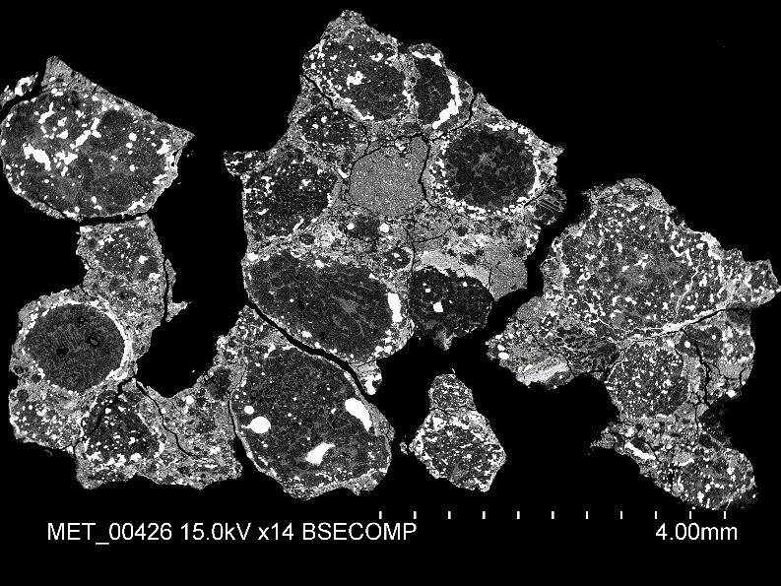
chondrules are the dominant component of undifferentiated meteorites

Slide 47
chondrules are the dominant component of undifferentiated meteorites
in between: matrix, which can have materials that interacted with H₂O, and CAIs

Slide 48
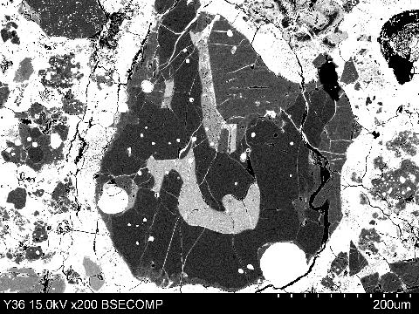
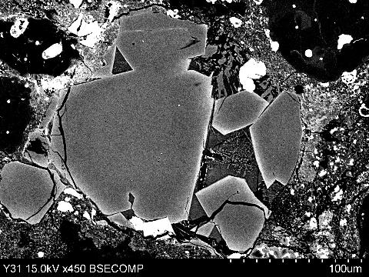
chondrule to chondrule variability in olivine FeO contents, from within the same carbonaceous chondrite
Fe-rich metal
lpx
quenched melt (SiO₂-rich)
quenched melt
olivine
Fe-rich metal
ol
Olivine molar % FeO endmember content: 1.2
Olivine molar % FeO endmember content: 27.7
**From olivine-metal phase equilibria, chondrules with FeO-rich olivine formed in more oxidized environments than chondrules with FeO-poor olivine. Was H₂O the oxidizing agent?**
olivine: (Mg, Fe)₂SiO₄
fayalite (FeO endmember): Fe₂SiO₄
forsterite (MgO endmember) Mg₂SiO₄

Slide 49
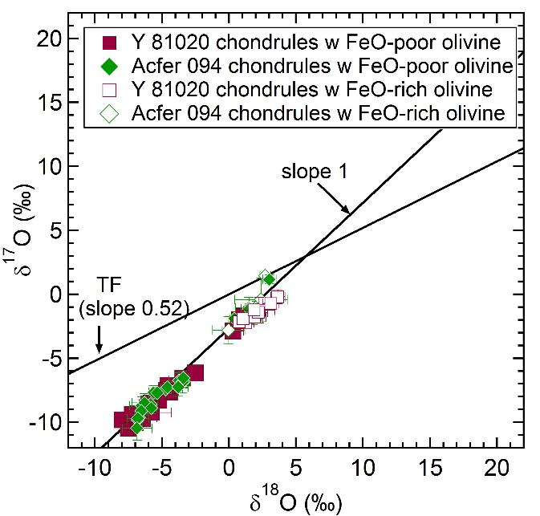
Heavy isotope-enriched H₂O inferred from meteorite matrix phases
**Overall, oxygen isotope ratios of chondrules from carbonaceous chondrites indicates variable mixing of H₂O into early Solar System materials**
chondrules from a more oxidized environment. More H₂O?
chondrules from a more reduced environment. Less H₂O?

Slide 50
Other SIMS techniques: depth profiling
Rick Hervig, UCLA SIMS workshop 2009

Slide 51
Depth profiling by SIMS is a useful technique for quality control of multi-layered materials
TEM micrograph of a Si-SiGeC multilayer
LeThanh et al. 2002. Materials Science and Engineering

Slide 52
From Rick Hervig. UCLA SIMS workshop 2009

Slide 53
Another SIMS application: trace analysis (in this case, of hydrogen in upper mantle phases)
SIMS standards on 1 inch diameter SIMS mount
Tenner et al. 2009. Chemical Geology
2.5 cm

Slide 54
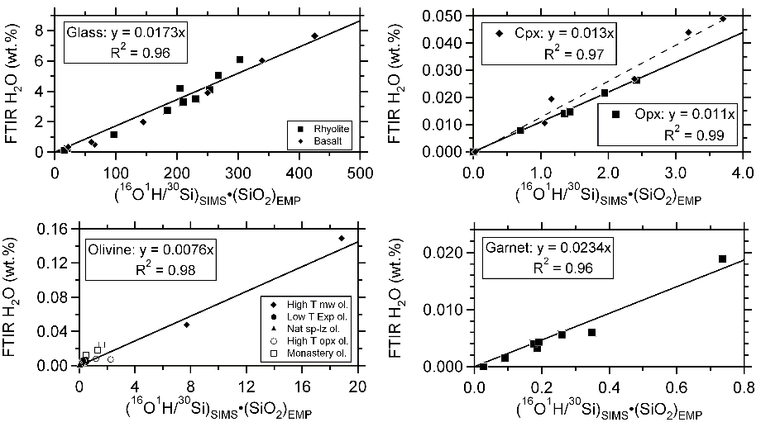
SIMS phase specific calibrations
Tenner et al. 2012. Contributions to Mineralogy and Petrology

Slide 55
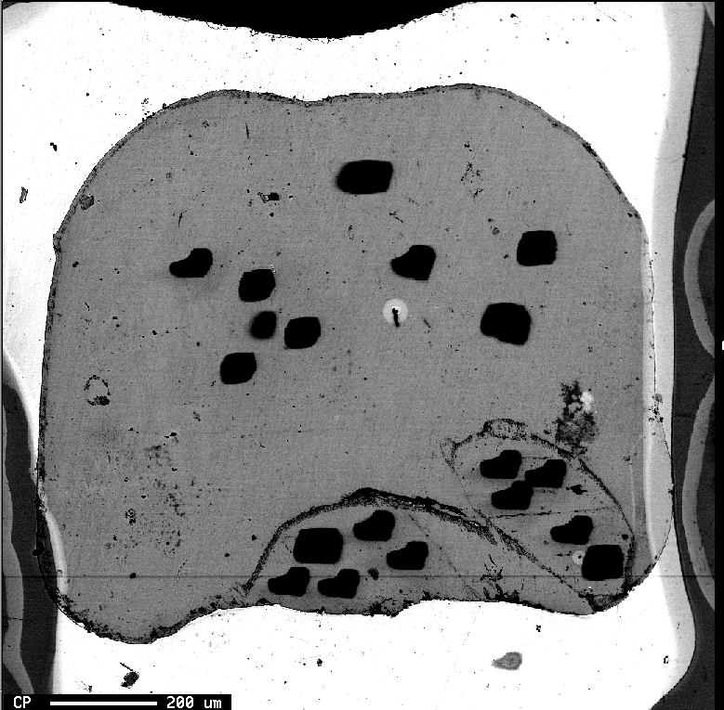
High pressure, high temperature experiment 4 GPa, 1405ºC
glass avg: 4.8 ± 0.6 wt.% H₂O
D_{H20}^{cpx/melt}: 0.024 ± 0.004
D_{H20}^{opx/melt}: 0.021± 0.003
glass avg: 4.8 wt.%
opx avg: 0.100 ± 0.004 wt.%
cpx avg: 0.116 ± 0.007 wt.%
cpx avg: 0.116 wt.%

Slide 56
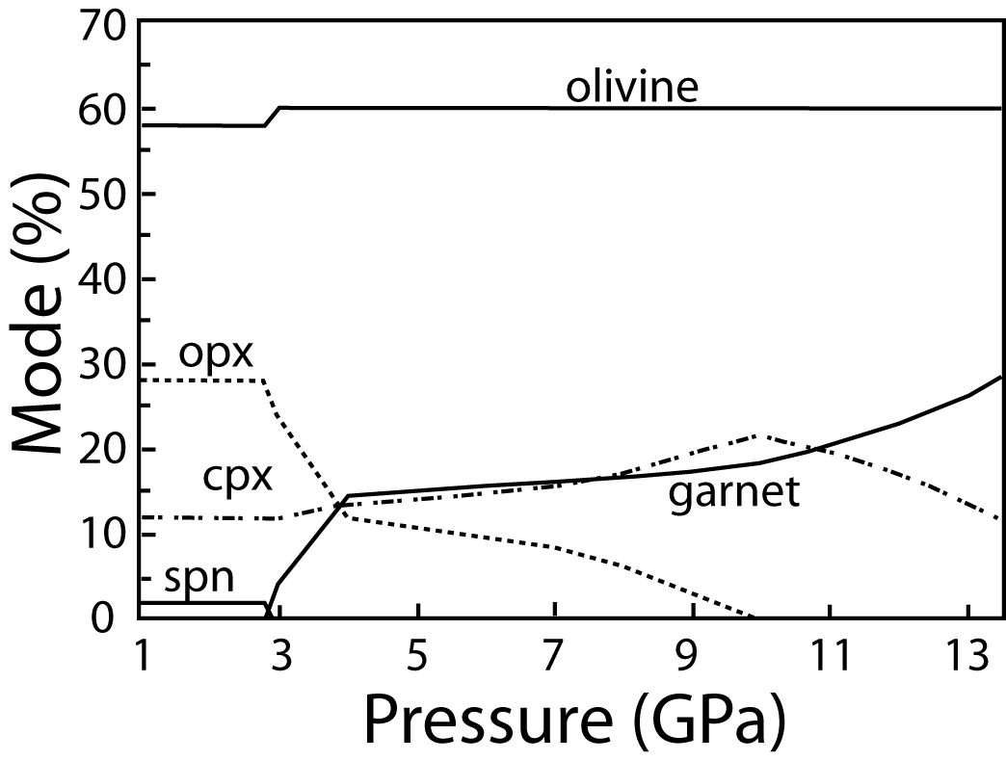
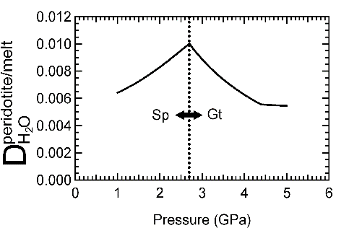
Combining mineral/melt H₂O partition coefficients with mineral modal abundances allows for estimating peridotite/melt H₂O partitioning with depth.
Hirschmann et al., 2009. Physics of the Earth and Planetary Interiors

Slide 57
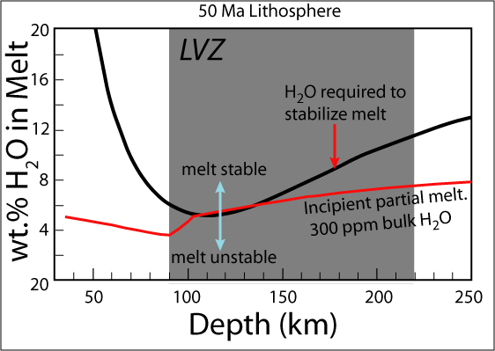
Combining peridotite/melt H₂O partitioning with estimated bulk mantle H2O concentrations can help us determine where hydrous partial melt might be stable in the upper mantle, which might explain observed seismic low velocity zones (LVZ).

Slide 58
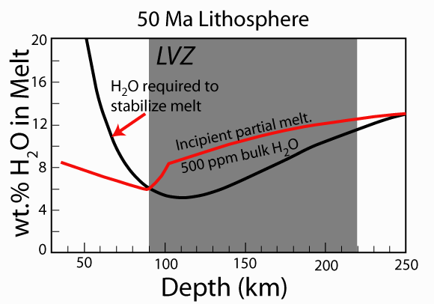
Bulk H₂O beneath ridges: 50 – 200 ppm. Not enough to induce hydrous partial melting.
Bulk H₂O beneath hotspots and associated w/subduction zones: 300 – 1000 ppm. Enough to induce hydrous partial melting, which may explain seismic low velocity zones at 90 to 220 km depth.

Slide 59
another SIMS application: rastered isotope imaging
MCF7 cell exposed to ¹⁵N-glutamine
Jiang et al. 2014 in press. Methods

